Slide 1




Intro to
for object oriented developers
presented by Bryan Hunter Firefly Logic
Twitter #Erlang #NashFP
@bryan_hunter
@fireflylogic

Slide 2
?

Slide 3
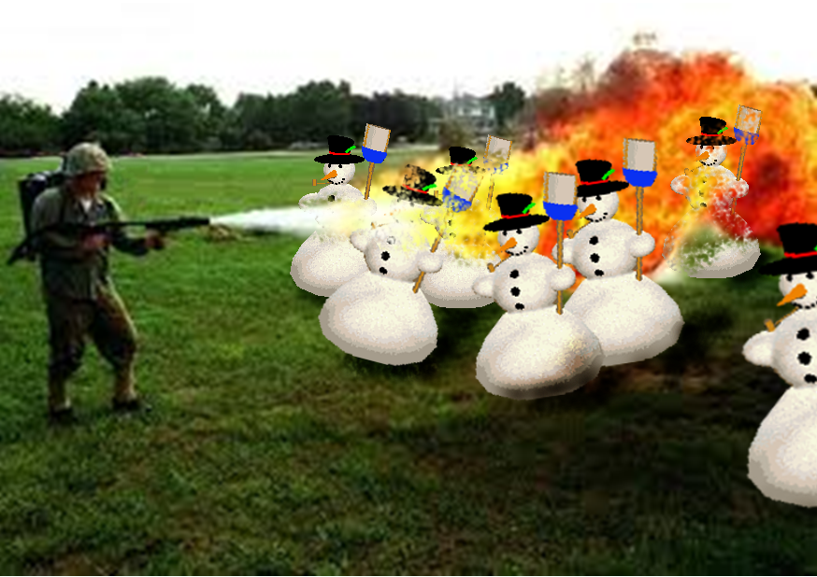
Right tool for the job!

Slide 4
What’s Erlang?
Erlang (the language)
+
OTP
+
The ERTS
(Erlang Runtime System)

Slide 5
Erlang (the Language)
Functional
immutability, higher-order functions, referential transparency, separation of behavior and data, recursion,
Concurrency- oriented
Different model of the world
Prolog roots
Pattern matching

Slide 6
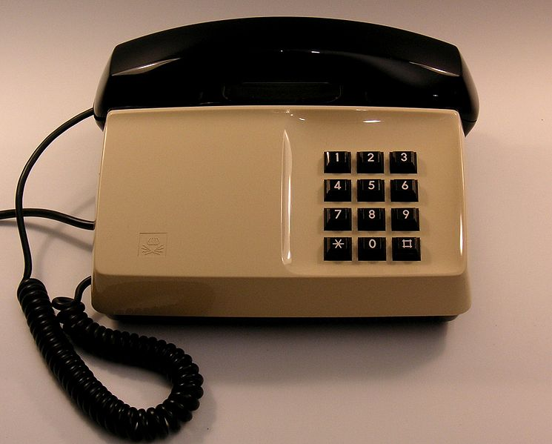
OTP

Slide 7
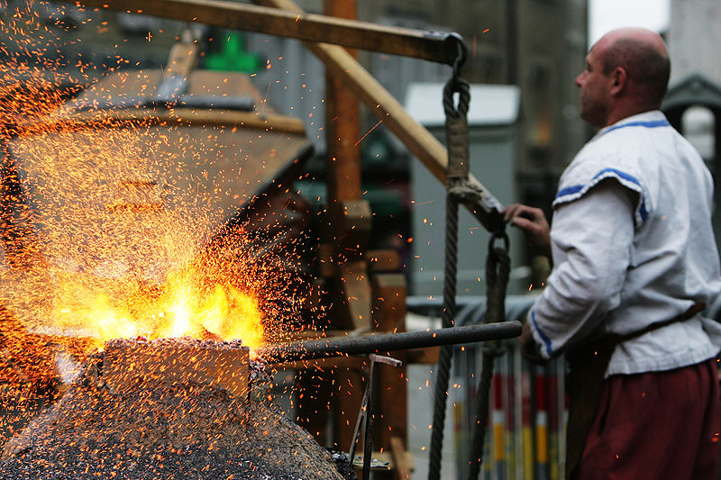
OTP
Erlang Runtime System

Slide 8
Erlang in less than 140 characters
Erlang is open, proven and cross-platform. It simplifies writing reliable, concurrent, distributed systems. Its pattern matching is FTW.

Slide 9
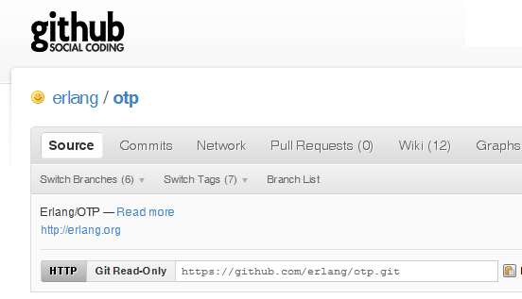

Why -> Erlang is open

Slide 10
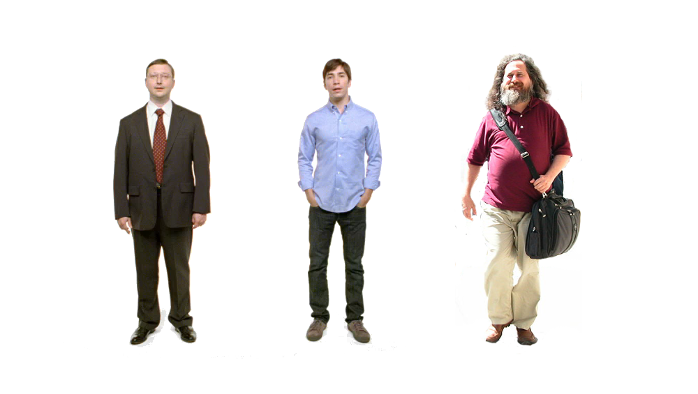
Erlang
Erlang
Erlang
Why -> Erlang is cross-platform

Slide 11













Why -> Erlang is proven

Slide 12
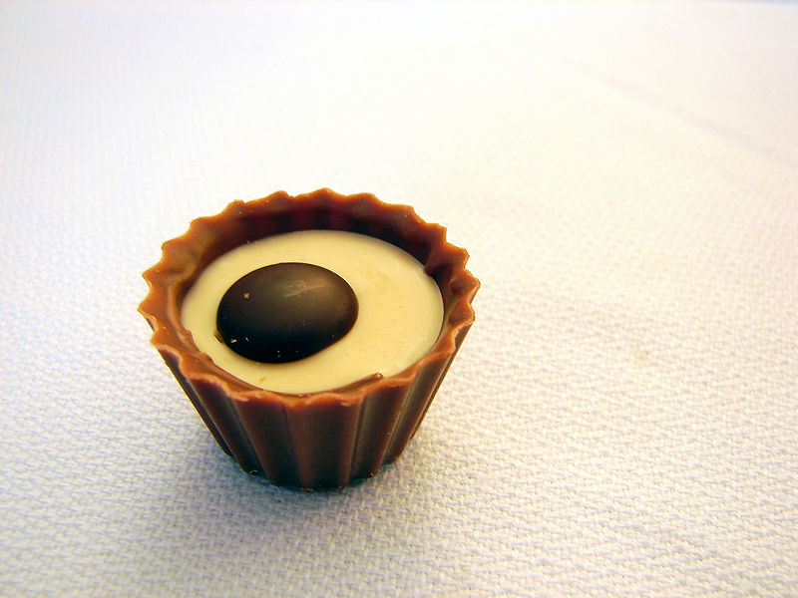
What are the sweet spots?

Slide 13
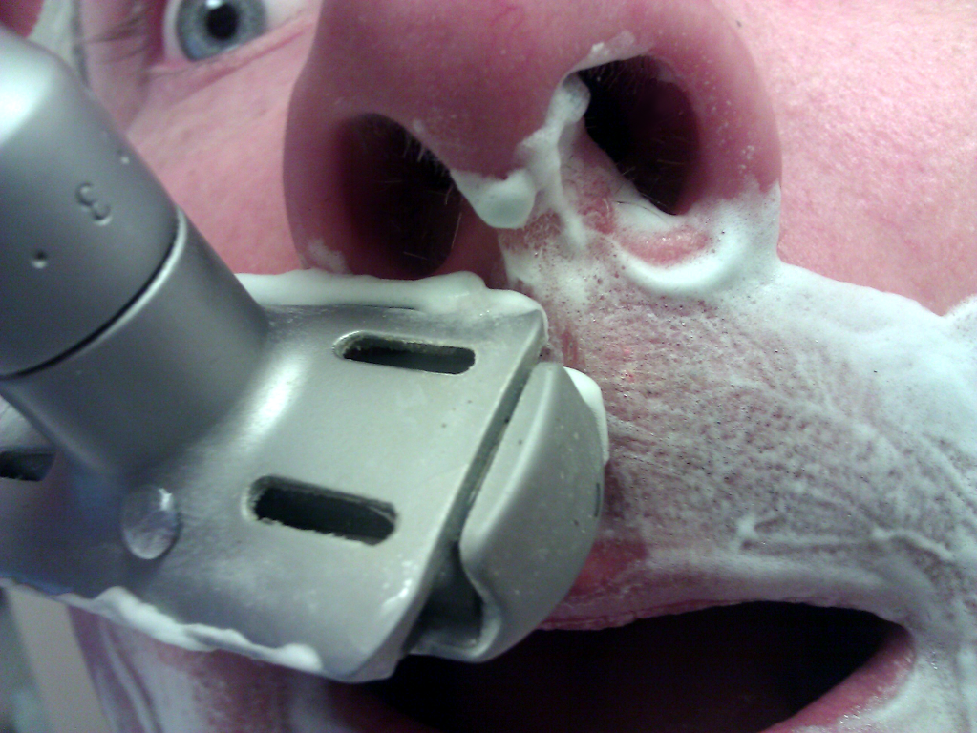
Why -> elsewhere concurrency is painful

Slide 14
Two thing to remember about
Concurrency
1) Shared memory concurrency is hard
2) Message passing concurrency is easy

Slide 15
“The performance
of a concurrent language
is predicated by three things:
the context switching time,
The message passing time,
and the time to create a process.”
–Mike Williams

Slide 16
Erlang Processes
are the unit of concurrency.
You structure your programs around these units of concurrency.

Slide 17
Java SE 6 64-bit or .NET 4.0 one thread (allocates one megabyte)
**********
**********
**********
**********
**********
**********
**********
**********
**********
**********
**********
**********
**********
**********
**********
**********
**********
**********
**********
**********
**********
**********
**********
**********
**********
**********
**********
**********
**********
**********
**********
**********
**********
**********
**********
**********
**********
**********
**********
**********
**********
**********
**********
**********
**********
**********
**********
**********
**********
**********
Heap
Mailbox
Stack
**********
**********
**********
**********
**********
**********
**********
**********
**********
**********
**********
**********
**********
**********
**********
**********
**********
**********
**********
**********
**********
**********
**********
**********
**********
**********
**********
**********
**********
**********
**********
**********
**********
**********
**********
**********
**********
**********
**********
**********
**********
**********
**********
**********
**********
**********
**********
**********
**********
**********
Garbage Collector
Links and Monitors
One Erlang Process (allocates one kilobyte)
*
Why -> elsewhere concurrency is painful

Slide 18
*
*
*
Reductions
- Do 2,000 operations
reduction1 reduction3 .
Reduction2000
- Move to the next guy - Repeat
CPU Core
Why -> elsewhere concurrency is painful

Slide 19
***** *****
***** *****
***** *****
***** *****
Core
Core
Core
Core
Why -> elsewhere concurrency is painful

Slide 20

Distribution: built-in from the start

Slide 21

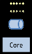
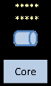
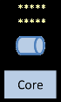
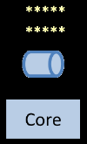
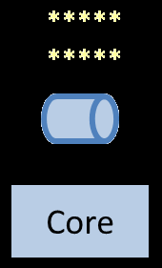
Distribution: built-in from the start

Slide 22
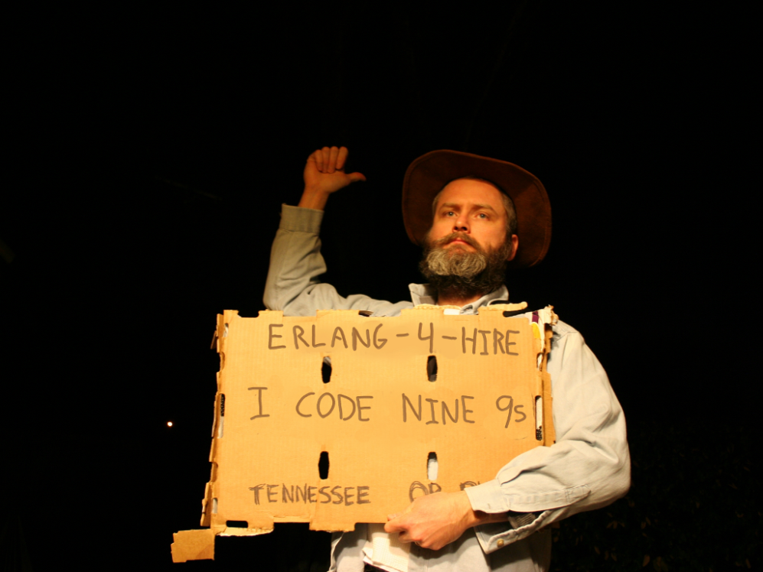
Nines | Uptime | Annual Downtime
9 | 99.9999999% | 30 milliseconds
8 | 99.9999990% | 300 milliseconds
7 | 99.9999900% | 3 seconds
6 | 99.9999000% | 32 seconds
5 | 99.9990000% | 5 minutes
4 | 99.9900000% | 53 minutes
3 | 99.9000000% | 8 hours, 46 minutes
2 | 99.0000000% | 3 days, 15 hours, 36 minutes
Safe
Supervisor
Worker
Worker
Links and monitors
No masters
Hot code loading
simple distribution, safe concurrency
Why -> reliability

Slide 23
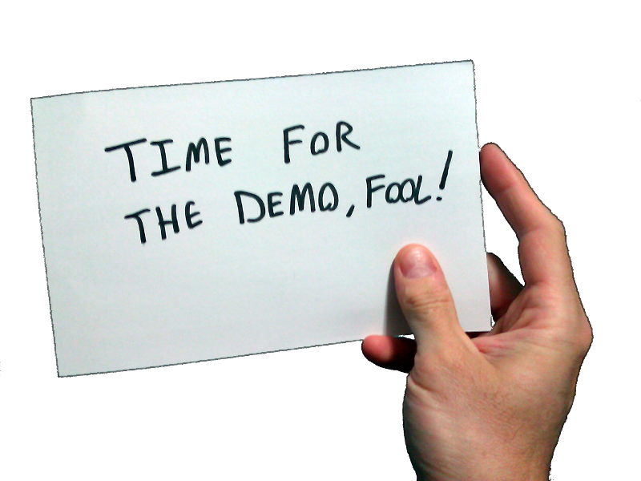
Erlang!
What exactly is Erlang?
Why Erlang?
How do you do it?
In the shell
In a text editor + command line + shell
In Emacs

Slide 24
[insert awe-inspiring demos here]

Slide 25
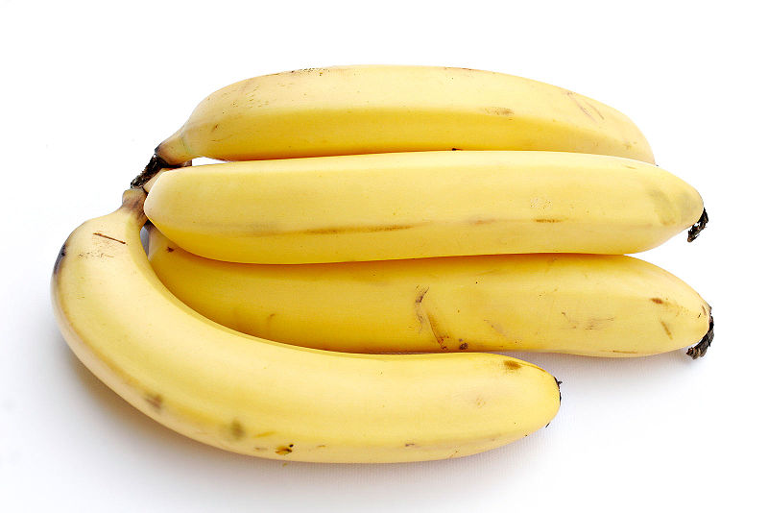

Slide 26
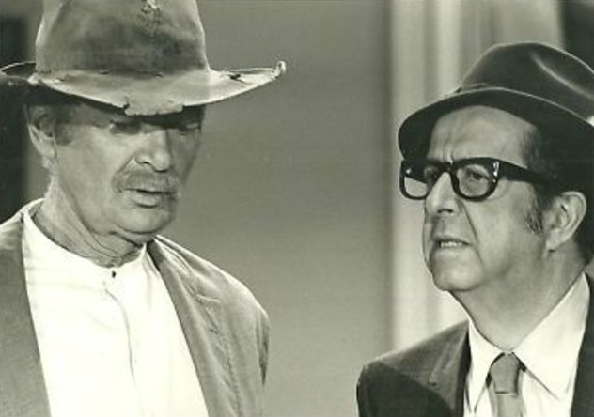
How do you begin to lose your OO accent?
View immutability as your friend
Stop hording state
Begin to use higher-order functions
Replace conditional logic with pattern matching
Begin to think recursively and replace loops with recursion
Start teasing out behavior from data

Slide 27
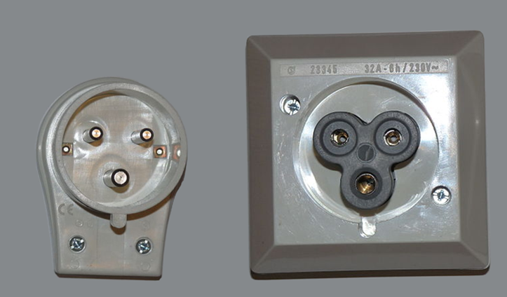
What are the best interop strategies?
You want me to do what!?

Slide 28
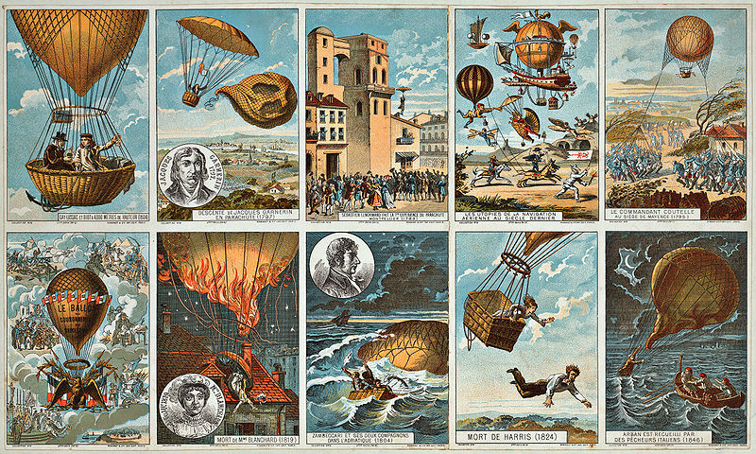
How to pilot Erlang?

Slide 29
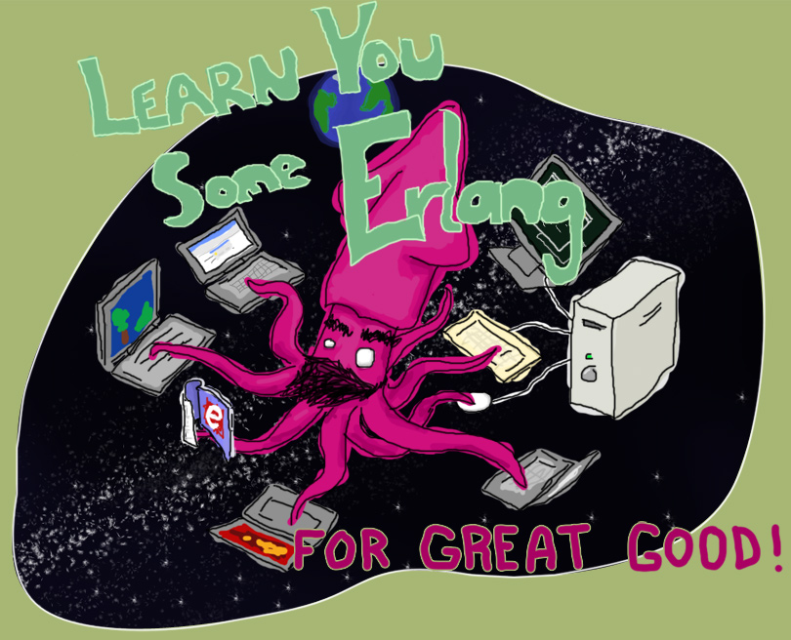
“Learn You Some Erlang for Great Good!” http://learnyousomeerlang.com/
How -> read this excellent and free online book

Slide 30



How -> read some books

Slide 31
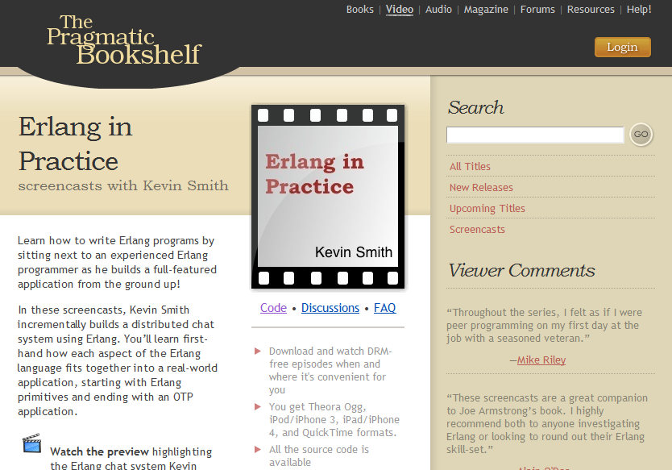
Search “pragmatic kevin smith”
How -> code alongside Kevin Smith for eight screencasts

Slide 32
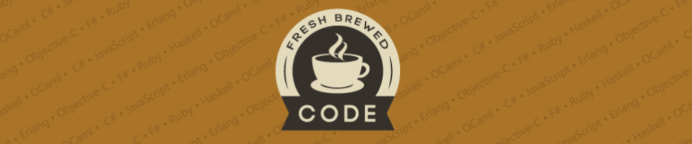
My blog:
http://freshbrewedcode.com/bryanhunter/
How -> visit my blog

Slide 33

http://nashfp.org
How -> join your local FP group

Slide 34
Bryan Hunter
Twitter: @bryan_hunter
Email: bryan.hunter@fireflylogic.com
Blog: codeswamp.com
Firefly Logic, Inc.
1000 Main Street, Suite 201 Nashville, TN 37206
http://fireflylogic.com
How -> keep in touch

